Slide 1
Review
Heat Transfer and Thermal Equilibrium
If two objects of different temperatures touch, thermal energy will move from the hotter object to the cooler object until they both reach the same temperature.
This state of balance is called thermal equilibrium.
During this process, energy is conserved: the heat energy lost by the hotter material is equal to the heat energy gained by the colder material.

Slide 2
Methods of Thermal Energy Transfer

Slide 3
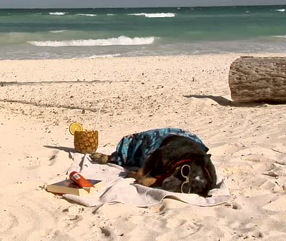
Learning Objectives
CFU
What are we going to learn?
Identify and describe the three methods through which thermal energy is transferred.
Activate Prior Knowledge
Think, Pair, Share: What happens to your body temperature when you lie on a towel in the Sun at the beach?

Slide 4
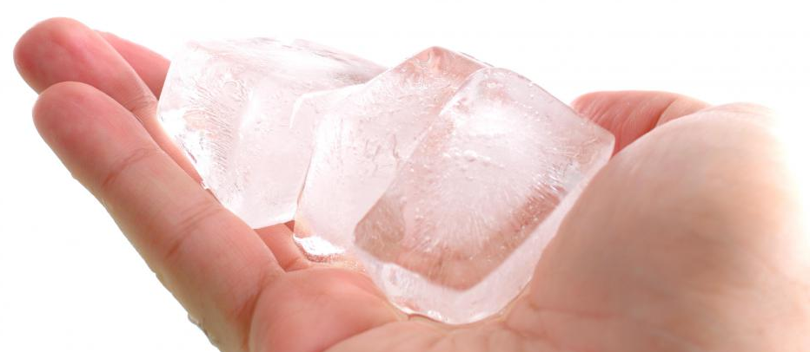
Concept Development
Conduction
Conduction occurs when two objects of different temperatures are in direct contact (touching).
Heat is transferred from one particle to another when those particles collide.
Consider what happens when an ice cube sits in your hand:
The quickly vibrating particles in your hand bump into the slower moving particles in the ice cube.
The particles in your hand transfer kinetic energy to the particles in the ice.
The average kinetic energy (temperature) of your hand’s particles decreases, and the average kinetic energy of the ice particles increases.

Slide 5
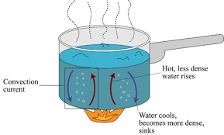
Concept Development
Natural Convection
Natural convection describes the motion of a fluid (liquid or gas) that is caused by natural forces within it.
The most common cause is buoyancy: hotter parts of the fluid are less dense, so they float upwards.
As the fluid flows around, it forms a convection current which carries thermal energy throughout the fluid.
Consider what happens when water is heated in a saucepan:
Thermal energy is transferred from the saucepan to the water through conduction.
The water particles near the metal heat up, and that part of the liquid becomes less dense.
The heated particles begin to rise, taking thermal energy with them, and cooler ones take their place.
Notes:
Natural convection also creates sea breezes!

Slide 6
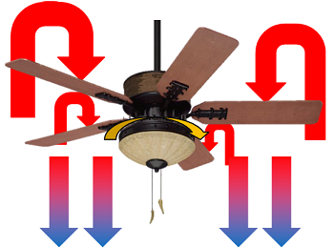
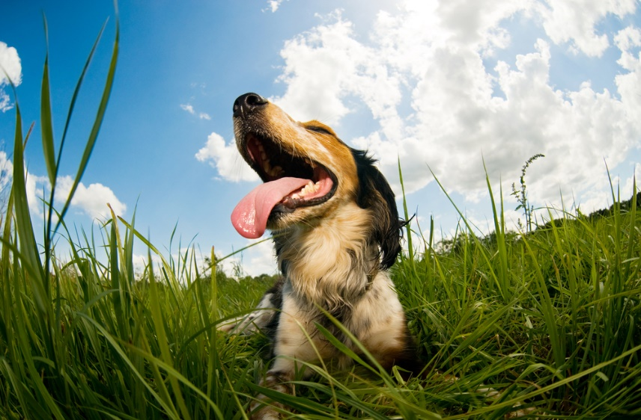
Concept Development
Forced Convection
Forced convection describes the motion of a fluid that is caused by forces outside of it.
These forces often move the fluid faster than or in a different direction to natural convection.
Fans in your house, your oven, and your computer all produce forced convection.

Slide 7
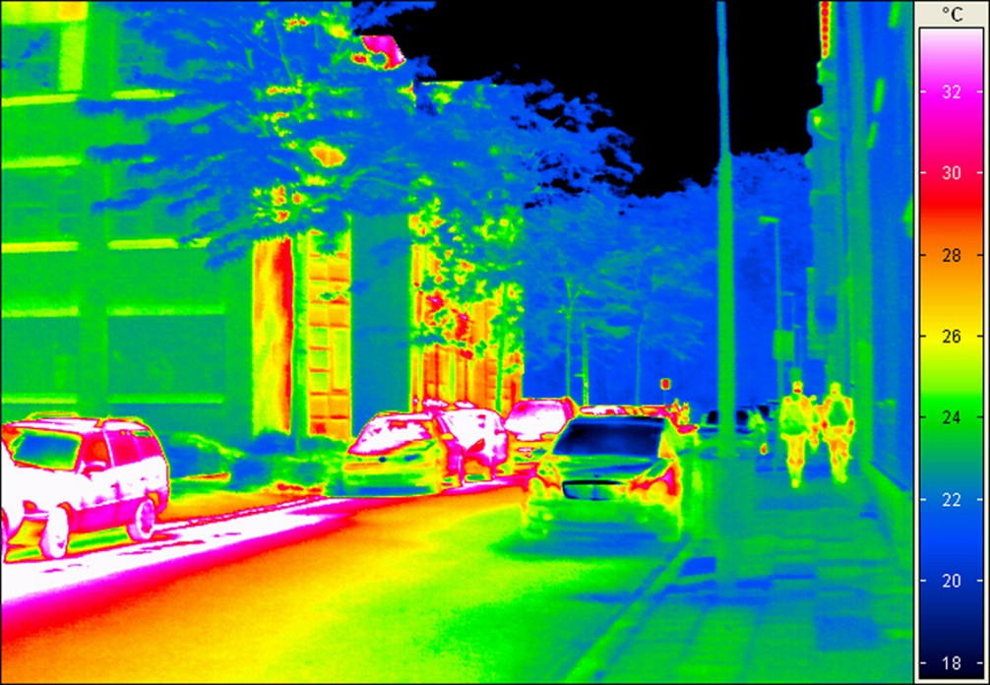
Concept Development
Radiation
Radiation consists of electromagnetic waves which transmit energy from a source to an absorber.
This is the only form of heat transfer that does not involve the movement of particles.
The higher the temperature of the emitter, the greater the amount of radiation emits.

Slide 8
Concept Development
Radiation
Objects can radiate and absorb electromagnetic radiation at the same time.
Objects with temperatures higher than their surroundings radiate more energy than they absorb, so they cool down.
Objects with temperatures lower than their surroundings absorb more energy than they radiate, so they warm up.

Slide 9
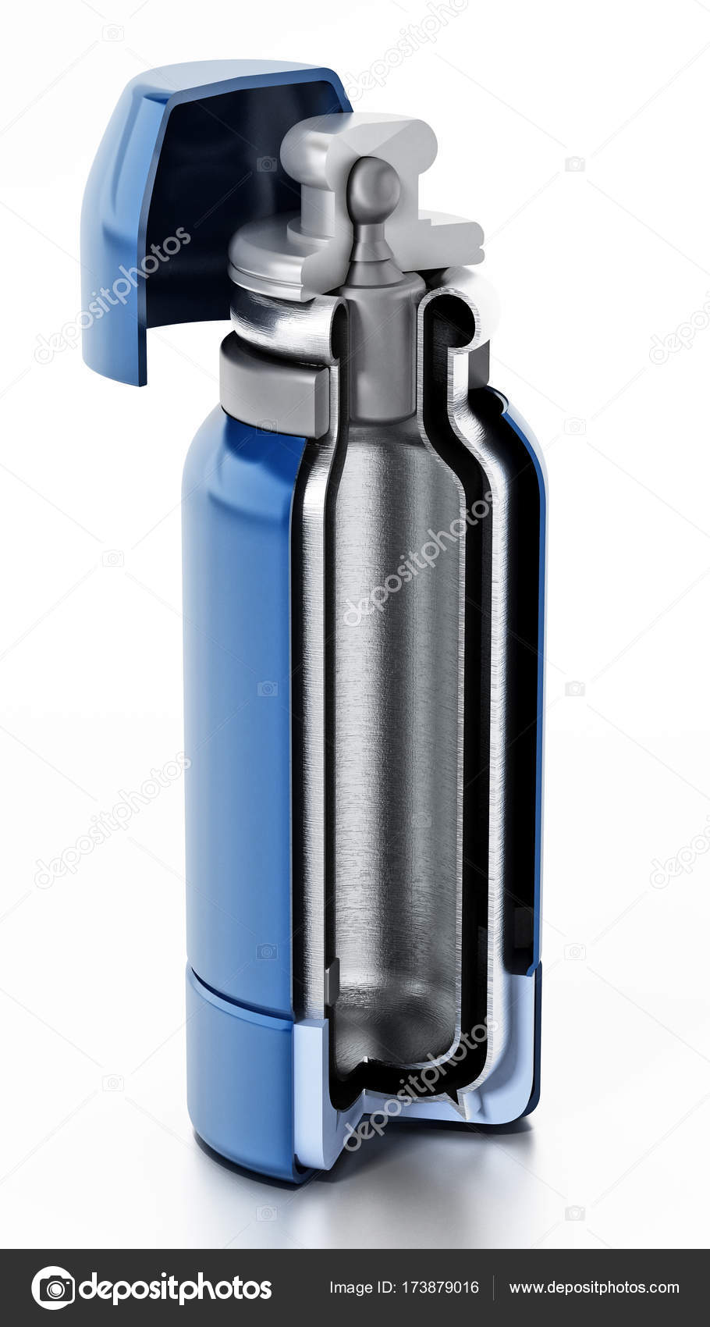
Concept Development
Radiation
In general, the surface of the body affects how efficiently it radiates and absorbs radiation.
Smooth surfaces don’t radiate or absorb much; rough surfaces do.
Reflective or white surfaces don’t radiate or absorb much; dark/black surfaces do.

Slide 10
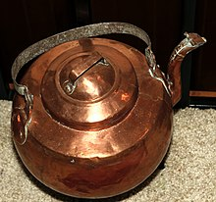
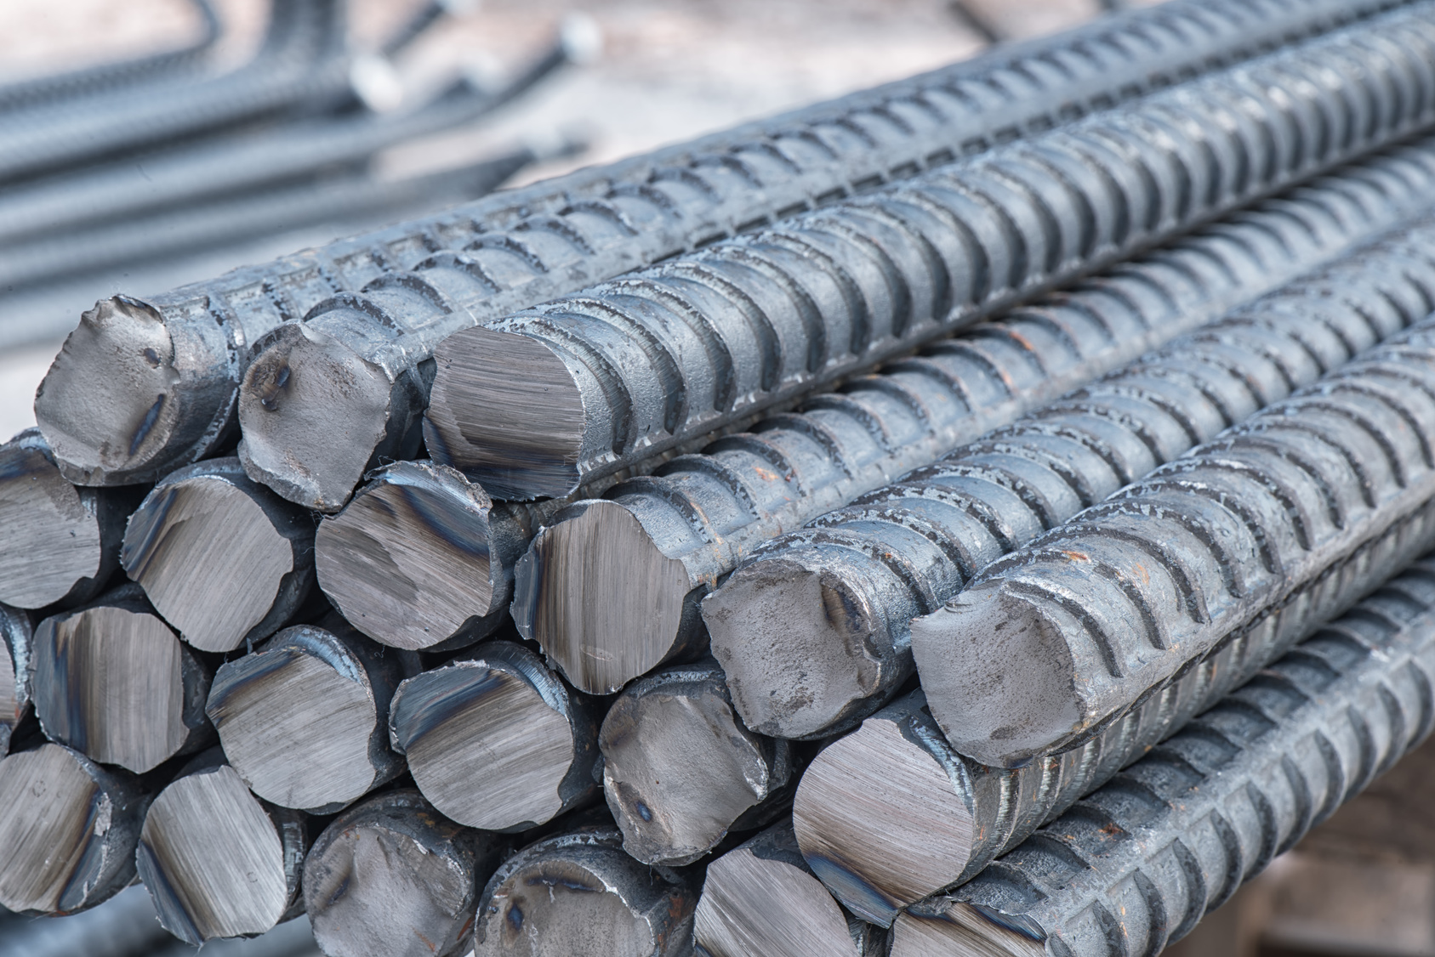
Concept Development
Conductors
A thermal conductor is any material through which thermal energy flows quickly.
Metals such as copper and iron are good conductors of thermal energy.
Some conductors are better than others, transferring energy more easily.

Slide 11
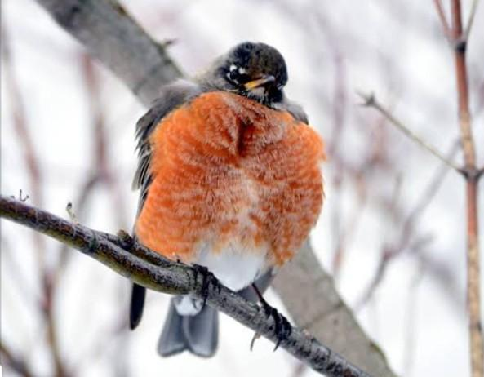
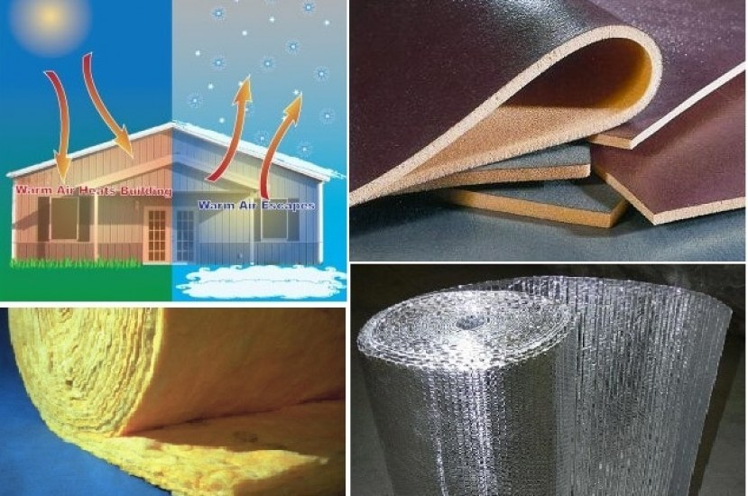
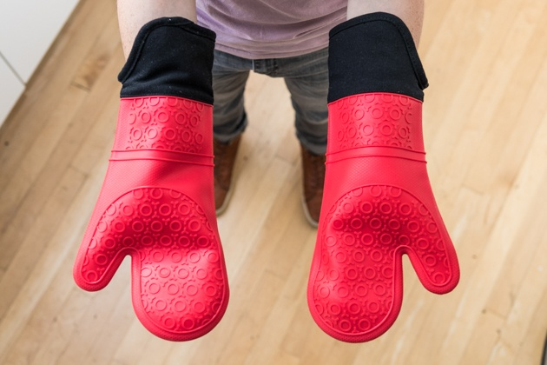
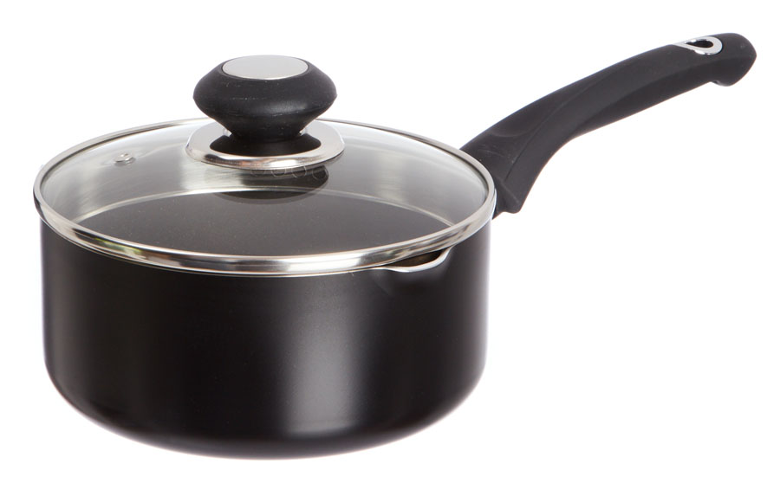
Concept Development
Insulators
A thermal insulator is any material through which thermal energy flows slowly.
Most non-metallic materials (e.g. air, plastic, wood, rubber) are good thermal insulators.
Some insulators are better at preventing energy transfer than others.

